Slide 1
Survival Campout Expectations

Slide 2
What you will be doing
Add activity examples here

Slide 3
What you will be eating
Add meal/food examples here

Slide 4
How you will be sleeping
List MB shelters and advanced skills tent option
(note between the committee only - we will put the advanced skills scouts in a separate campsite from the MB scouts, so that the activities of one group don’t distract the other – if attendance is small we’ll grab sites 7 and 8, otherwise we’ll grab 6, 7, 8, and 9 in Area A - https://files.nc.gov/ncparks/maps-and-brochures/jordan-lake-state-recreation-area-new-hope-overlook-access-area-map.pdf)

Slide 5
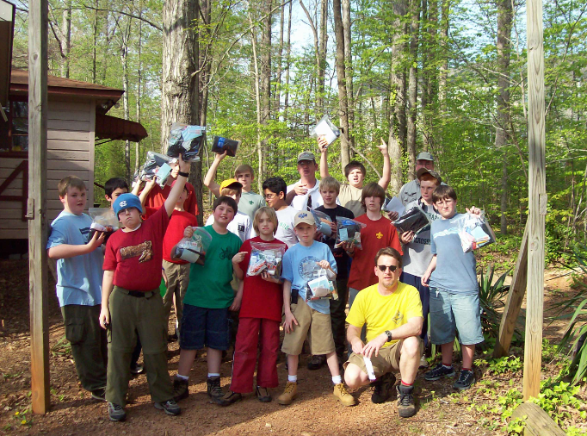
Troop Survival – Apr 2008
Scouts with all their gear for the weekend

Slide 6
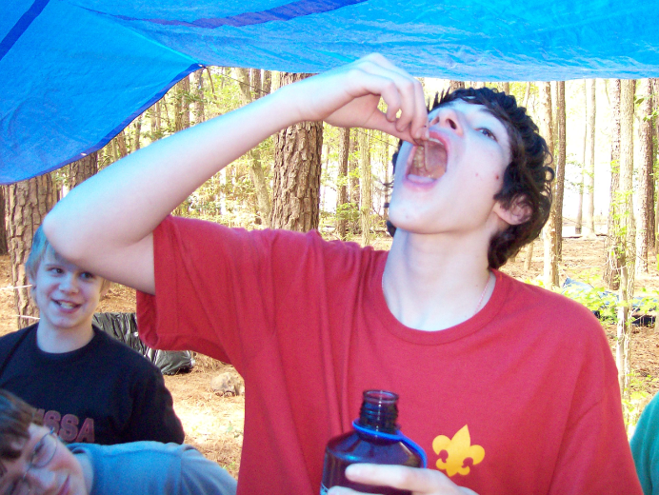
Troop Survival – Apr 2008
Swallowing a worm - yummy

Slide 7
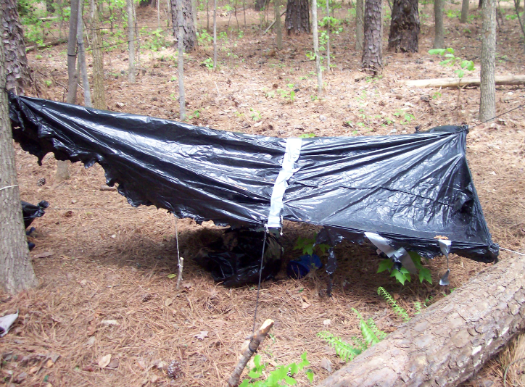
Troop Survival – Apr 2008
Not all shelters are created equally

Slide 8
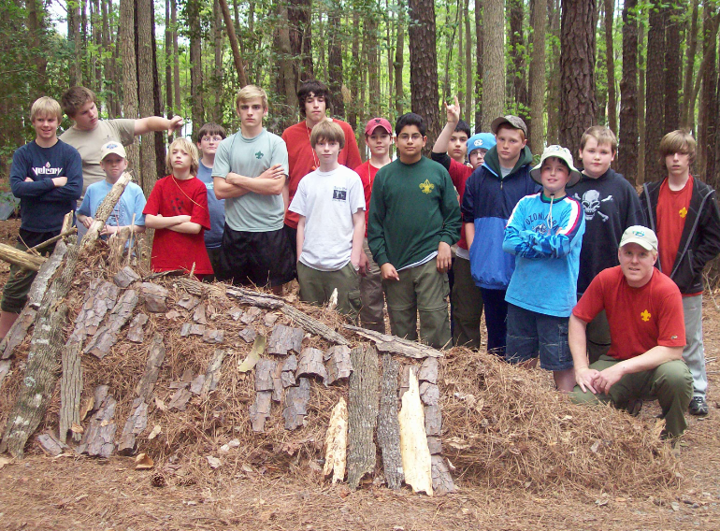
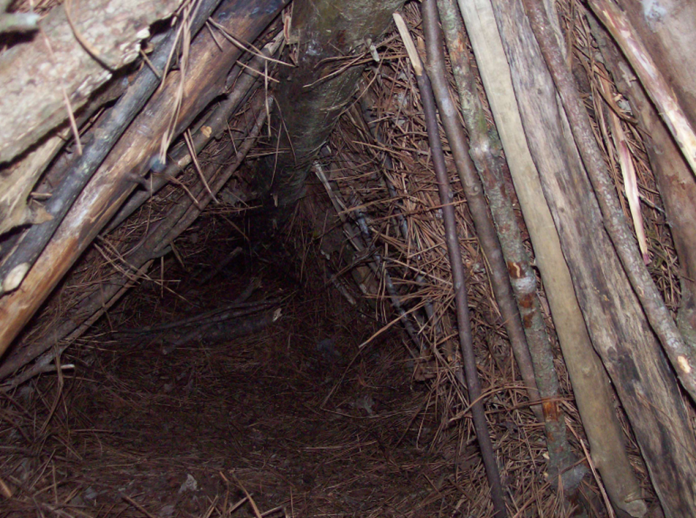
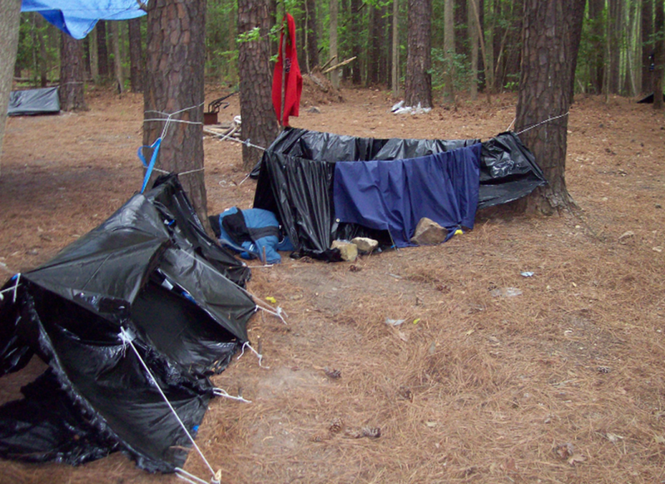
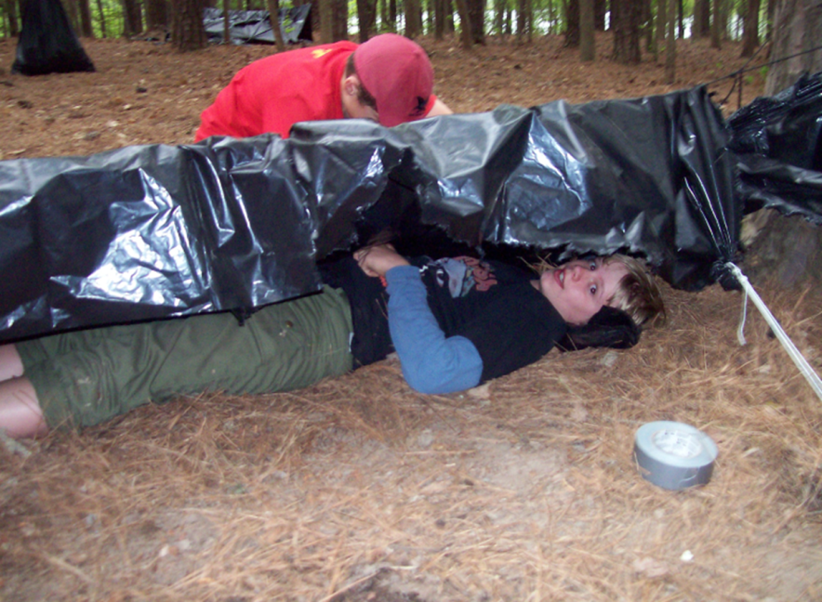
Troop Survival – Apr 2008

Slide 9
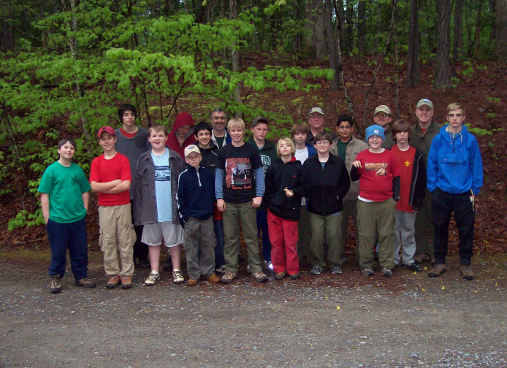
Troop Survival – Apr 2008
Sunday morning – everyone survived and thrived – 4 scouts in that photo became SPLs

Slide 10
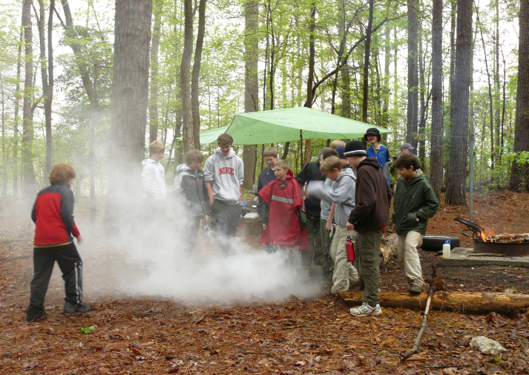
Troop Survival – Apr 2011
Rescue signaling

Slide 11
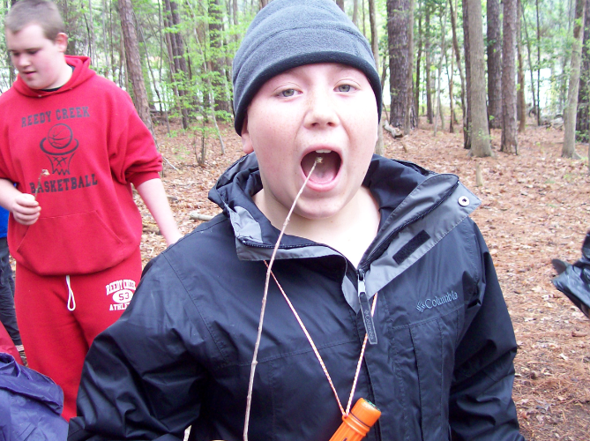
Troop Survival – Apr 2011
Eating a cooked cricket - yummy

Slide 12
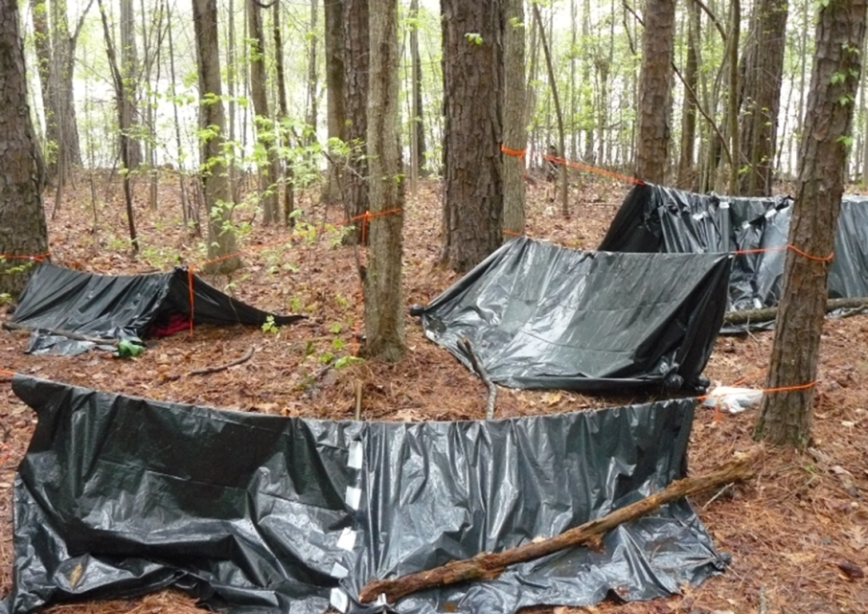
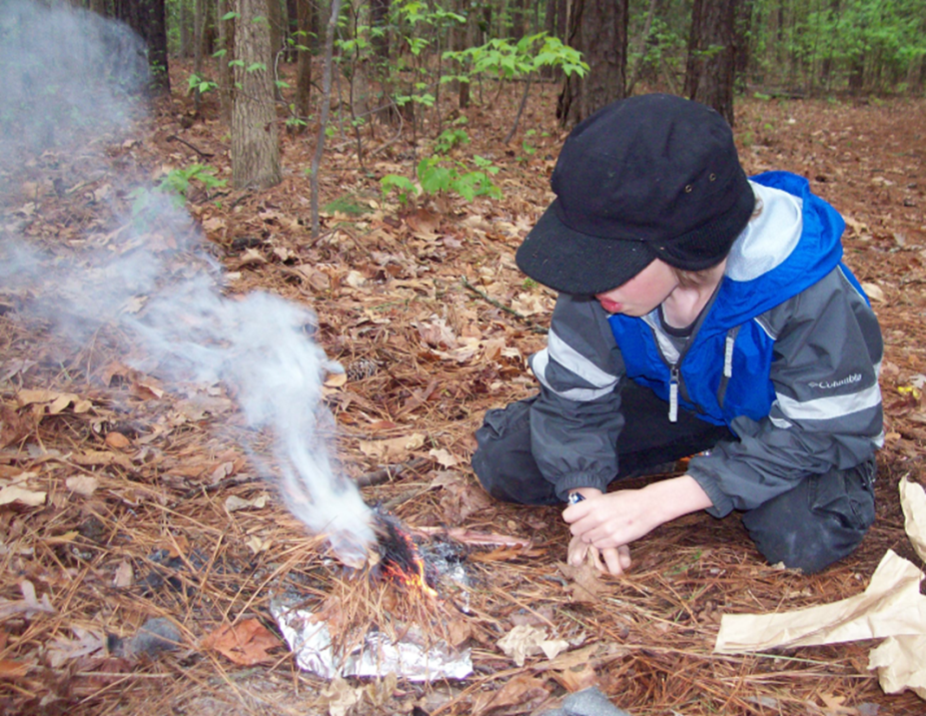
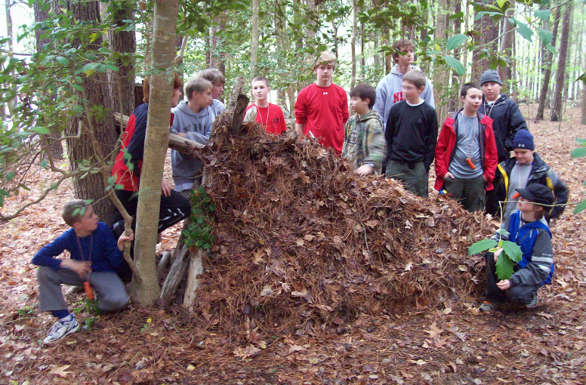
Troop Survival – Apr 2011

Slide 13
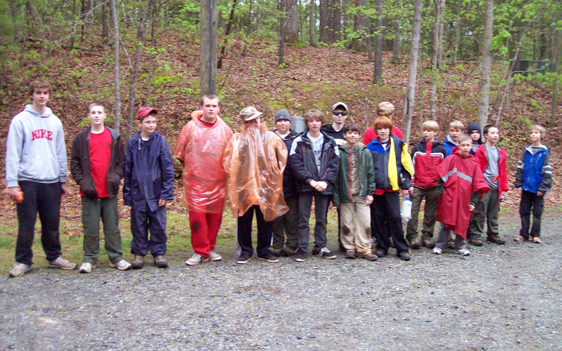
Troop Survival – Apr 2011
Sunday morning – everyone survived – 4 of these scouts became SPL

Slide 14
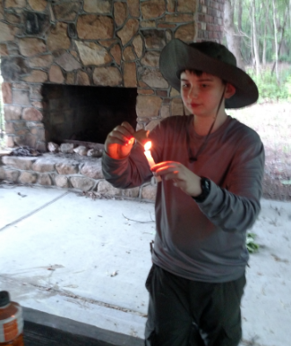
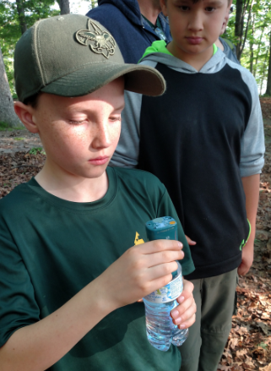
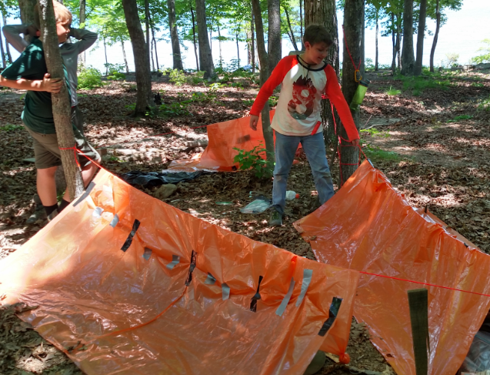
Troop Survival – May 2018
3rd troop campout for these scouts (and others)

Slide 15
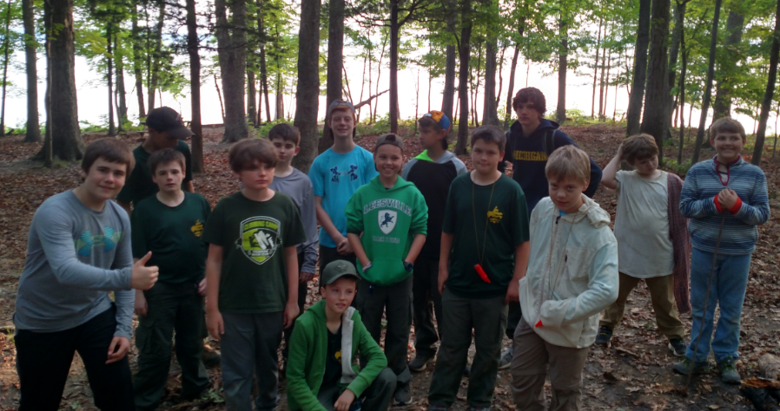
Troop Survival – May 2018
Sunday morning – everyone survived

Slide 16
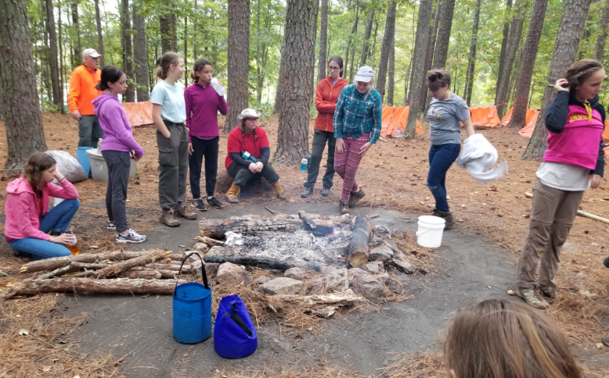
Troop Survival – Sep 2019
The girls are ready to tackle the survival weekend and earn the MB

Slide 17
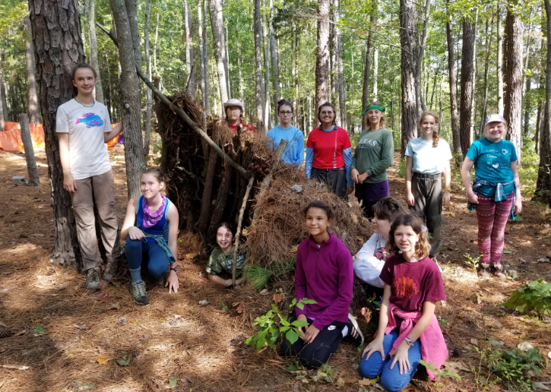
Troop Survival – Sep 2019
Half A-frame, half lean-to shelter

Slide 18
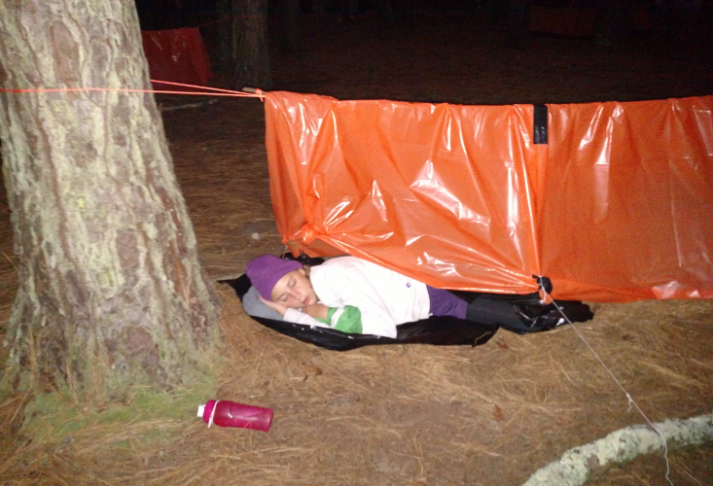
Troop Survival – Sep 2019
Sleeping soundly

Slide 19
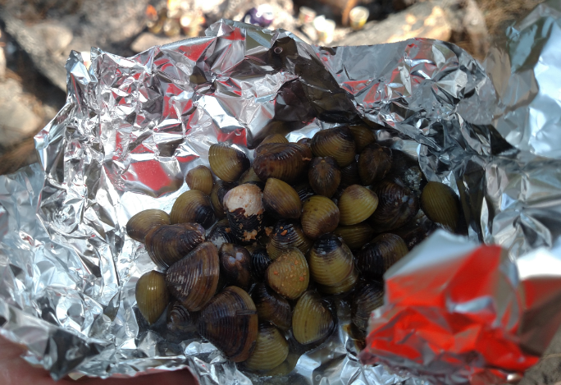
Troop Survival – Sep 2019
Time for a clam bake

Slide 20
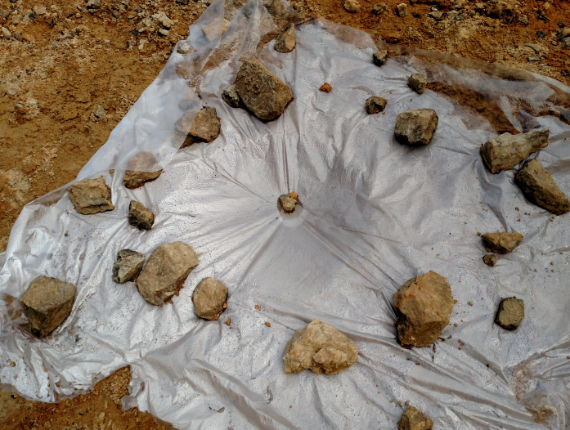
Troop Survival – Sep 2019
Collecting clean water underneath via evaporation

Slide 21
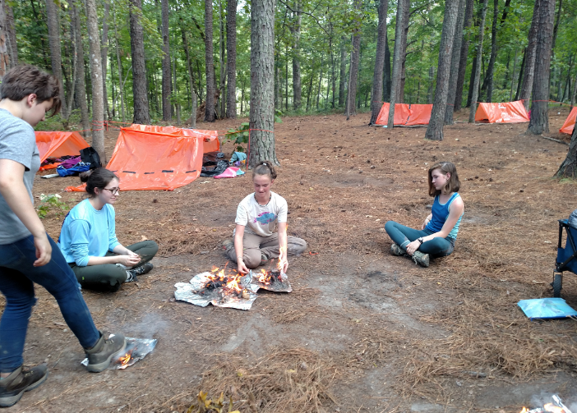
Troop Survival – Sep 2019
Making fire, again

Slide 22
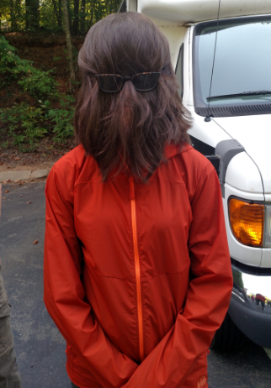
Troop Survival – Sep 2019
Sunday morning back at the Hut – survived the weekend, I think

Slide 23
More challenging survival

Slide 24
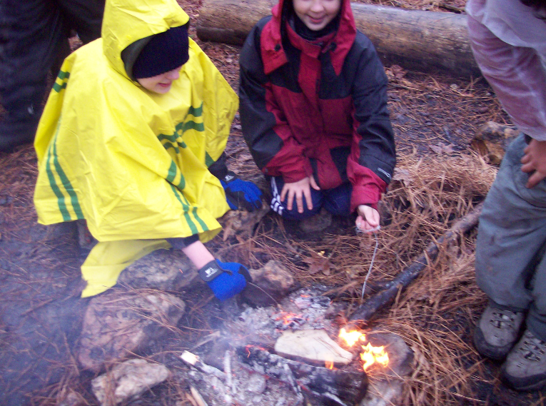
Troop Survival – Feb 2009
It was 53 degrees just after midnight Saturday, and dropping

Slide 25
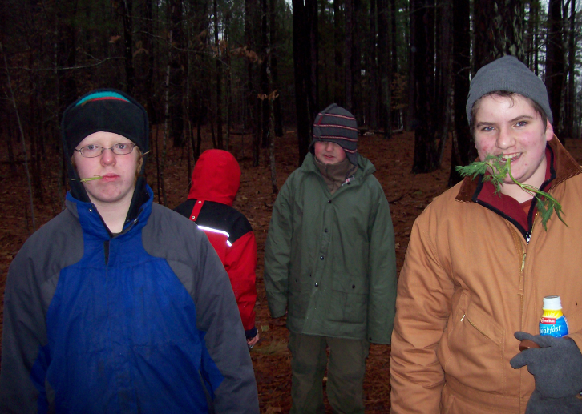
Troop Survival – Feb 2009
Eating grasses/plants - yummy

Slide 26
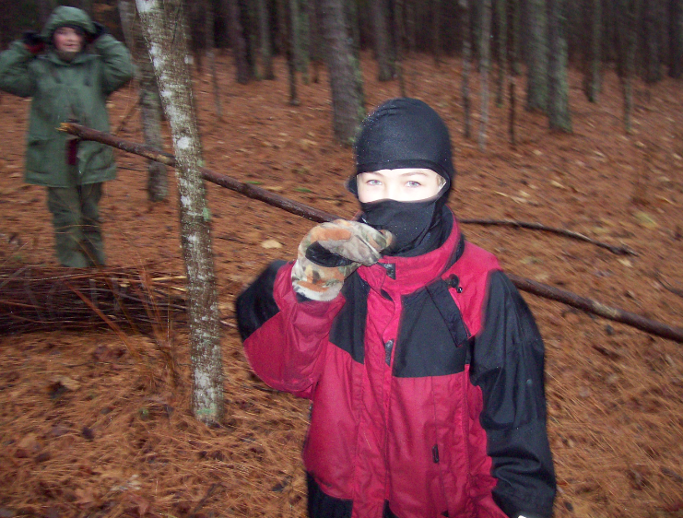
Troop Survival – Feb 2009
It started raining steadily around 9am, and was 40 degrees around noon

Slide 27
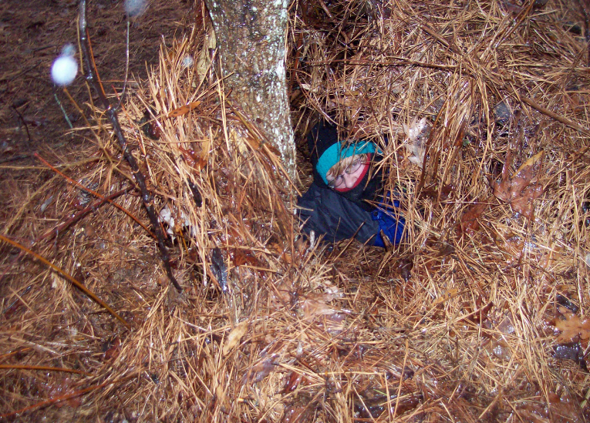
Troop Survival – Feb 2009
Inside primitive shelter

Slide 28
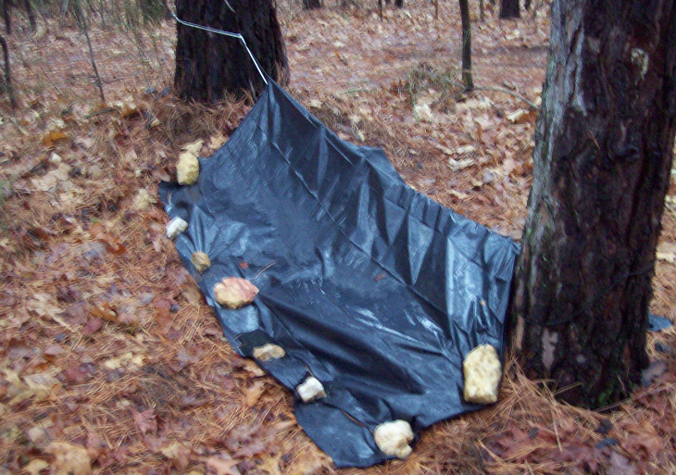
Troop Survival – Feb 2009

Slide 29
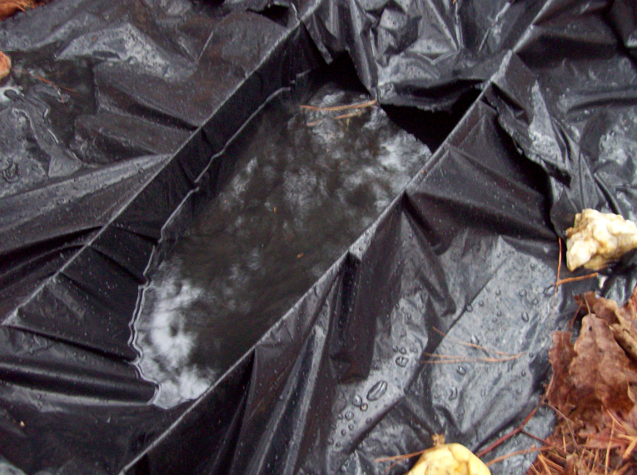
Troop Survival – Feb 2009
Shelter design failure – and by 4pm it was below 40 degrees

Slide 30
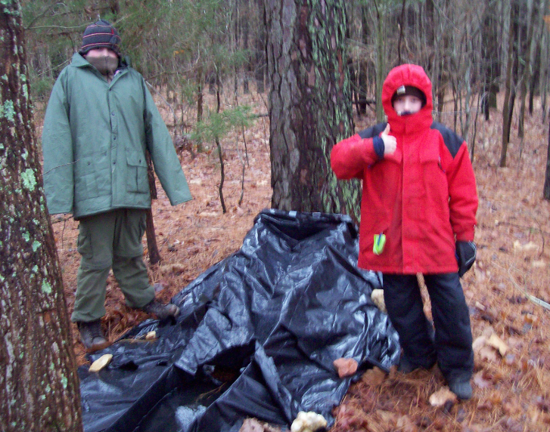
Troop Survival – Feb 2009
Scout spirit remains strong regardless

Slide 31
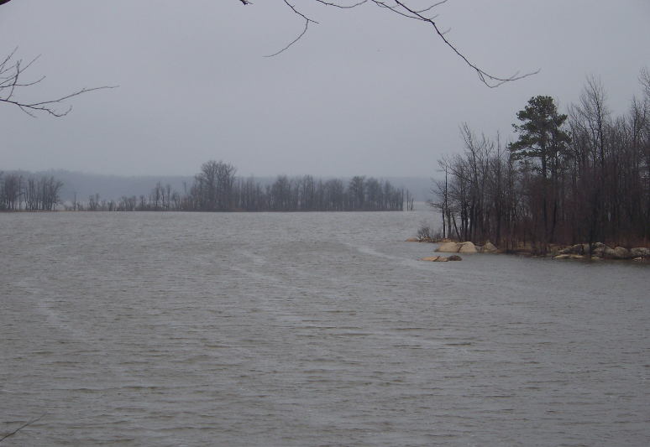
Troop Survival – Feb 2009
It is hard to keep a fire going in constant rain and near freezing temps

Slide 32
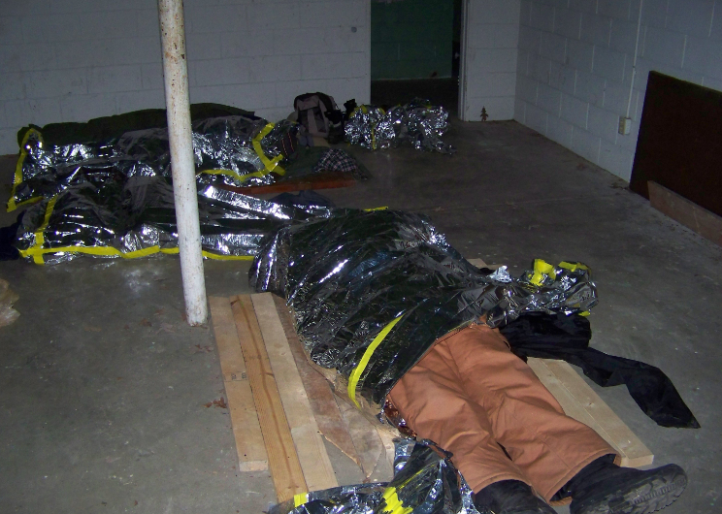
Troop Survival – Feb 2009
By 9pm it was a steady 34 degrees for the rest of the night – we had to abandon our shelters and sleep in an unheated cinder block building with no sleeping bags – just emergency bags – we all survived

Slide 33
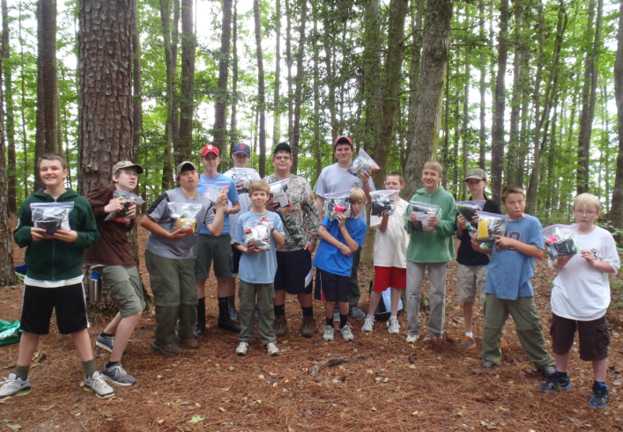
Troop Survival – Jun 2012
This trip wasn’t too bad, but there were a lot of bugs – 4 of these scouts became SPLs

Slide 34
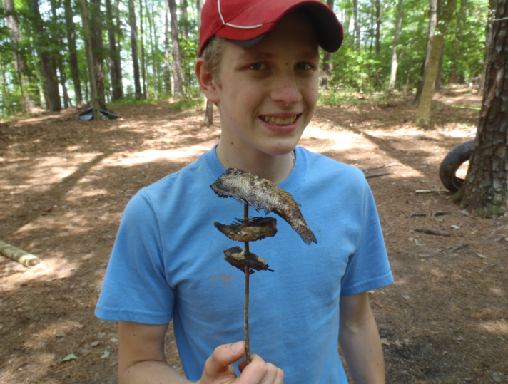
Troop Survival – Jun 2012
Gourmet dining – freshly caught fish

Slide 35
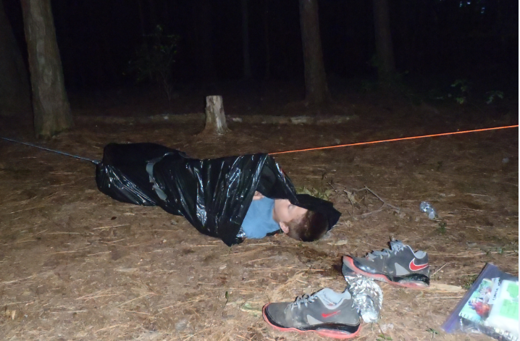
Troop Survival – Jun 2012

Slide 36
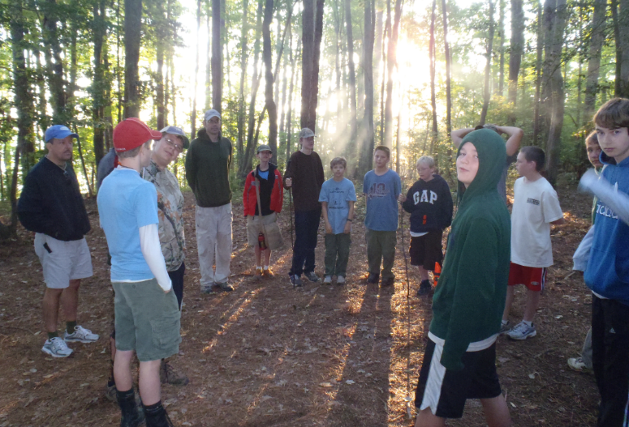
Troop Survival – Jun 2012
Sunday morning – all survived

Slide 37
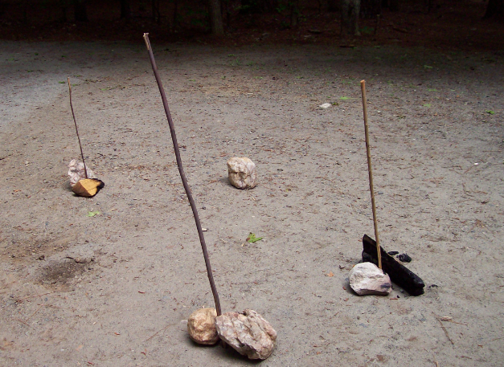
Random pics from trips
Compasses when ground is too hard to drive a stick into it

Slide 38
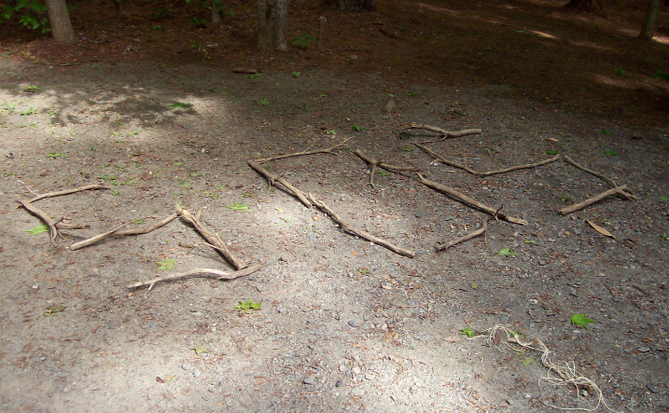
Random pics from trips
Rescue signaling

Slide 39
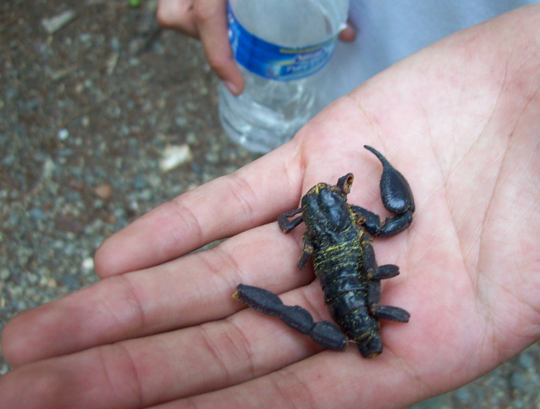
Random pics from trips
Scorpion meal – not yummy

Slide 40
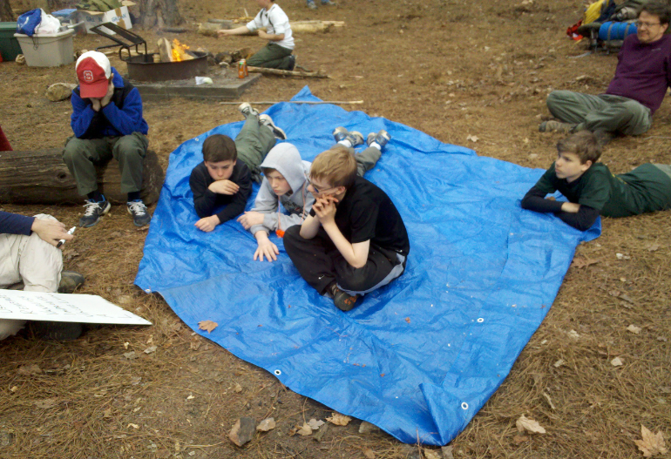
Random pics from trips
Outdoor classroom

Slide 41
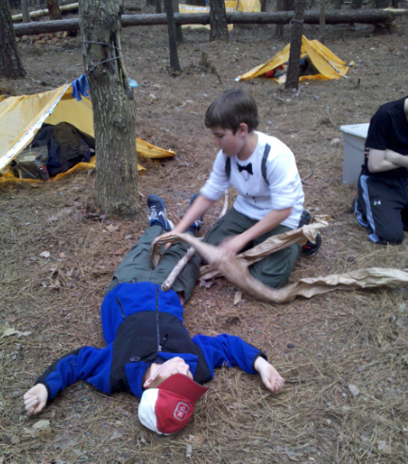
Random pics from trips
Wilderness First Aid – victim did survive

Slide 42
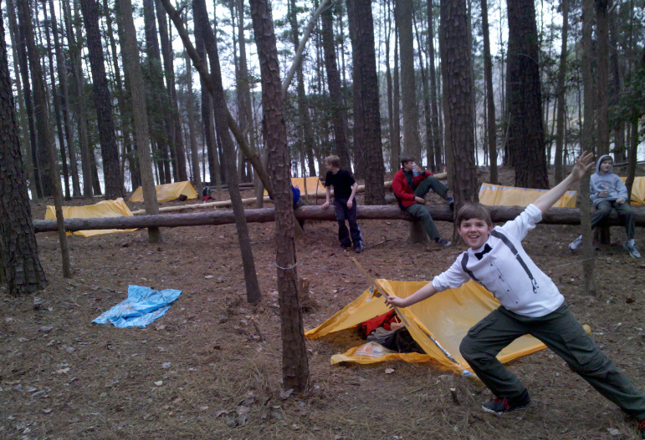
Random pics from trips
March 2014 – formal attire for his first troop campout

Slide 43
The End

